Slide 1
Sentimental Analysis and Topic Modeling of COVID – 19 Vaccine Tweets
IDS 566 : Advanced Text Analytics
Tarun S (UIN: 654229662)
Kavya V (UIN: 658400629)
Sanjay M (UIN: 662505955)

Slide 2
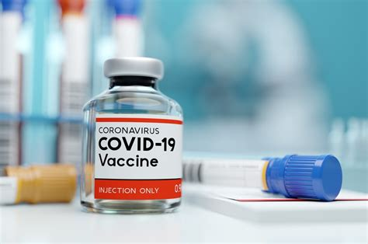
PROBLEM STATEMENT
COVID – 19 led to more than 907K deaths in USA alone. To mount a fight against it, numerous COVID – 19 vaccines were developed.
However, due to various propagandas and misinformation surrounding the vaccines, the sentiment towards the vaccines turned negative in many regions.
To find the sentiment towards the vaccines in different regions, we used tweets, sent out by people on twitter.
These sentimental analysis can be used identify areas where additional awareness about the vaccines are needed.

Slide 3
METHODOLOGY
Data Cleaning
Remove unwanted characters (hashtags, URLs, special characters, multiple spaces)
Sentimental Analysis
Detect most positive and negative words using VADER.
Use KDE graph to visualize the distribution of positive and negative tweets.
Topic Modelling
Used Latent Dirichlet allocation (LDA) for topic modelling.
Tokenization
Used Topic Coherence to get best number of topics using c_v measure.

Slide 4
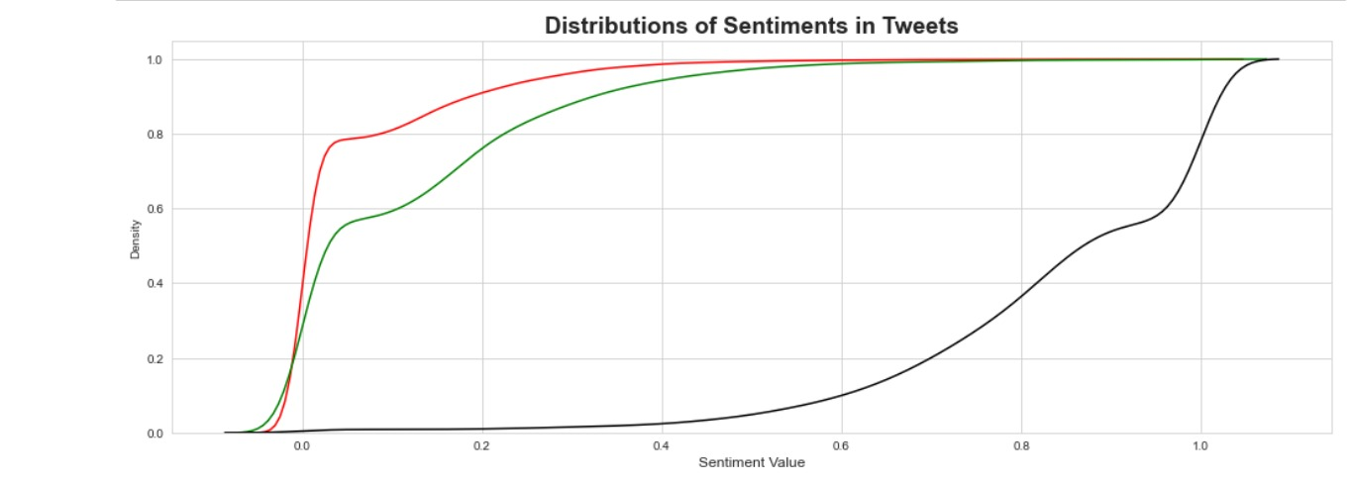
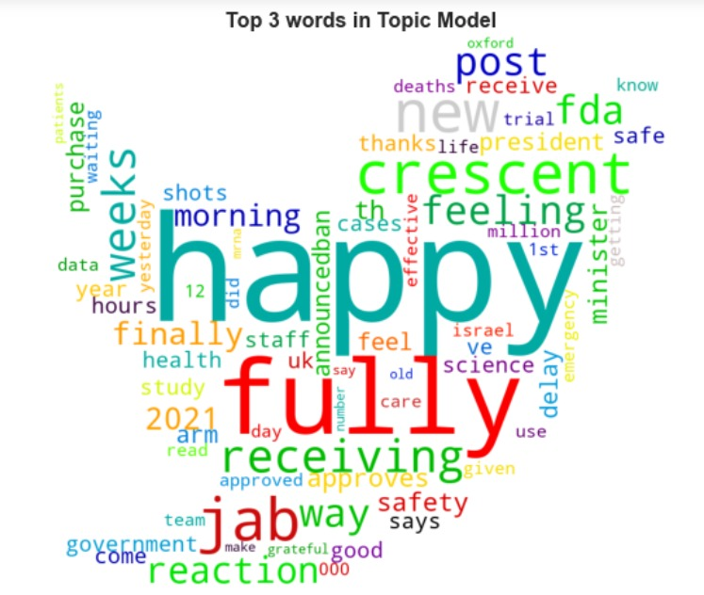
RESULTS
Positive emotion regarding vaccination
Side effects after taking the jab
Approval of new vaccines

